Slide 1

EEE-2421: Electrical Drives and Instrumentation Credit Hours - 2 Segment - 5
Saif Sabbir
Lecturer
Department of CSE
International Islamic University Chittagong (IIUC)
Spring 2026

Slide 2
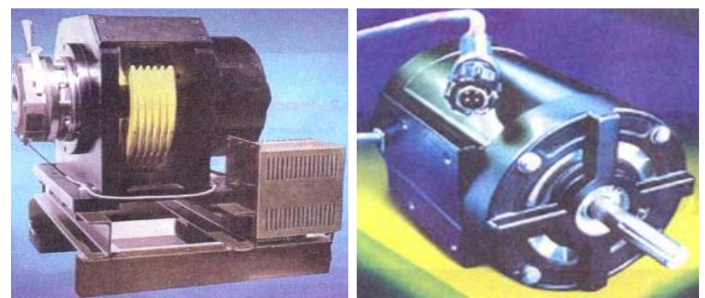
Synchronous Motors
➢An alternator may operate as synchronous motor like DC m/c
➢Synchronous motor (SM) is very similar to a synchronous gen.

Slide 3
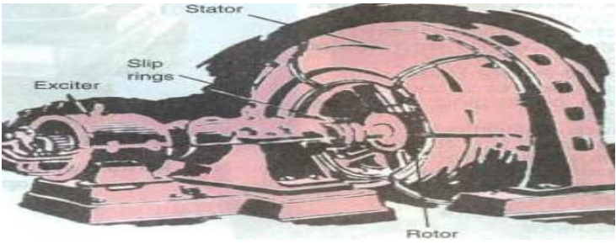
Synchronous Motors (Cont.)
➢Rated 15 MW~ 150kW (150~1800 rpm)..
➢It runs either at synchronous speed* Ns (120f/P) or not at all but N can be changed from f changing (f - converting)..
➢It is not inherently self starting…
➢Can be operated wide range of p.f. (lag-unity-lead) by field..

Slide 4
Synchronous Motors (Cont.)
➢ Synchronous speed: The speed at which the rotating field moves around the stator is called synchronous speed, Ns = 120f/P, usually measured in rpm.

Slide 5
Applications of Synchronous Motors
Synchronous motors are particularly attractive for constant speed & low speeds (< 300 r.p.m.) because the power factor can always be adjusted to unity and efficiency is higher
Overexcited synchronous motors can be used to improve the pf of system where lagging loads (IM, light, welders.. etc.)
They are used to improve the voltage regulation of transmission line (SM with field regulator, rise & fall controlled)
High-power electronic converters generating very low frequencies enable us to run SM at ultra-low speeds, Large motors in the 10 MW range are use in industry and variable-speed ball mills etc..

Slide 6
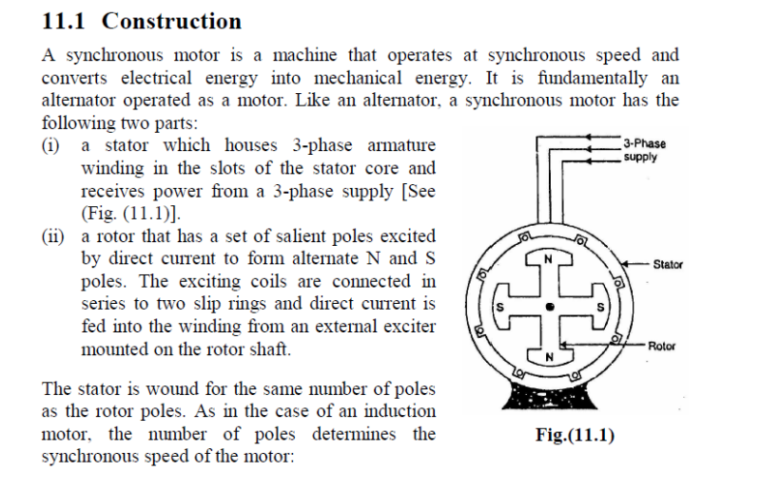
Construction of SM

Slide 7
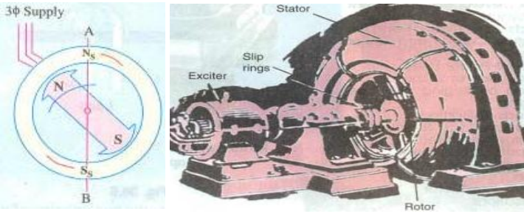
Operating Principle
➢Consider a 3-phase SM having two rotor poles NR and SR
➢The stator is designed for two poles NS and SS
➢DC applied to the rotor and a 3-phase voltage applied stator
➢The stator winding produces a rotating field which revolves round the stator at
synchronous speed Ns(=120 f/P)
➢A pair of revolving armature poles (i.e., Ns - Ss) and a pair of stationary rotor poles
(i.e., NR - SR )

Slide 8
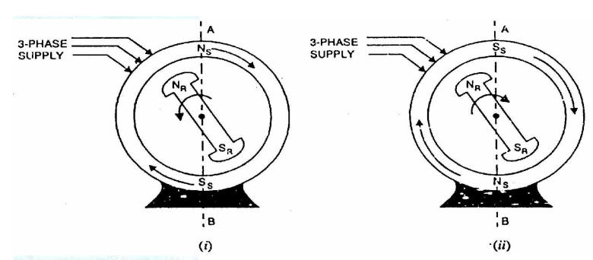
Operating Principle (Cont.)
➢Suppose at any instant, the stator poles are at positions Fig. NS and NR repel each other and so do the poles Ss and SR . The rotor tends to move in the ccw direction
➢After a period of half-cycle, the polarities of the stator poles are reversed but not the rotor poles. Now Ss and NR attract each other and so do Ns and SR .

Slide 9
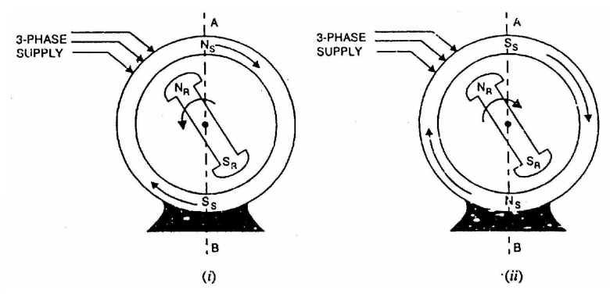
Operating Principle (Cont.)
➢Therefore, the rotor tends to move in the clockwise direction. Since the stator poles change their polarities rapidly, they tend to pull the rotor first in one direction and then after a period of half-cycle in the other. Due to high inertia of the rotor, the motor fails to start. Thus, SM has no self-starting torque

Slide 10
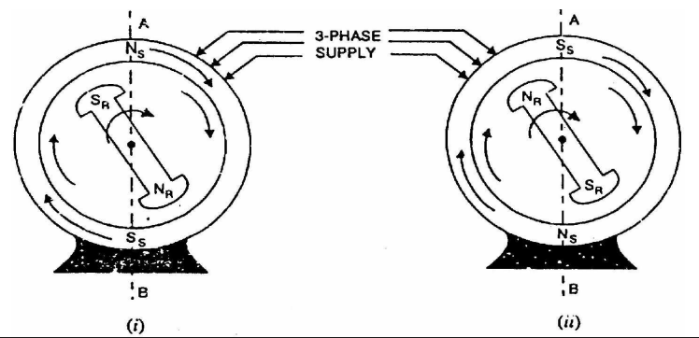
Operating Principle (cont.)
➢How to get continuous unidirectional torque? If the rotor poles are rotated by some external means at such a speed that they interchange their positions along the stator poles, then rotor will experience a continuous unidirectional torque
➢NR -Ss locked and vice versa both rotating synchronism at synchronous speed of the supply voltage.

Slide 11
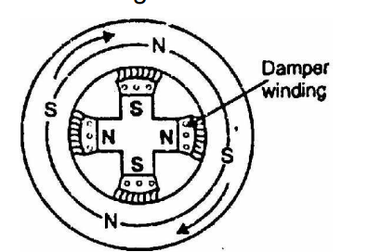
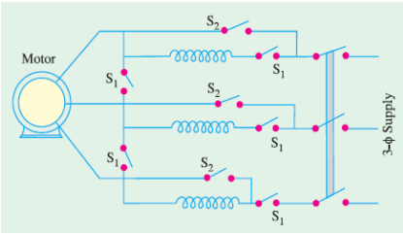
Methods of Starting
➢ The rotor has to be speed up Ns/near Ns by arrangements…
➢ NR -Ss and vice versa both interlocked for synchronism
➢ In reality rotor brought up to Ns by a) A shunt motor b) Exciter as a DC motor c) IM (less poles) & d) Damper winding as a IM

Slide 12
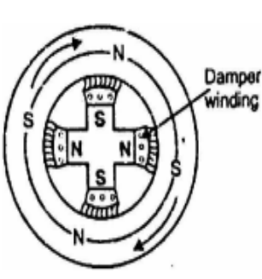
Making SM Self-Starting
A synchronous motor cannot start by itself., If stator is feed & rotor excitation is given motor develop no torque at standstill. It will develop running torque once it has been brought up to Ns. In order to make the motor self-starting, There are several methods of accomplishing this.
a) Induction start
b) Auxiliary devices
Induction start: All most all SM are equipped with squirrel cage winding (also called damper winding) is provided on the rotor. The damper winding consists of copper bars embedded in the pole face. The bars are short-circuited at both ends. Act as a IM during starting period

Slide 13
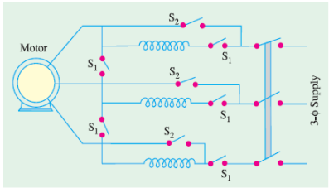
Making SM Self-Starting (Cont.)
Auxiliary devices:
(i) A direct coupled: DC/Induction Motor can be used rating is about 10% of SM, Pole less (min. 2)
(ii) SM as Alternator :
Synchronized with supply Now remove IM, will run as SM
(iii) Without Synchronizing:
Need to speed up by IM or DC motor near at Ns When Ns is reached, Stator is feed and rotor is excitated…
SM start……
(iv) Using the field exciter generator as a DC motor

Slide 14
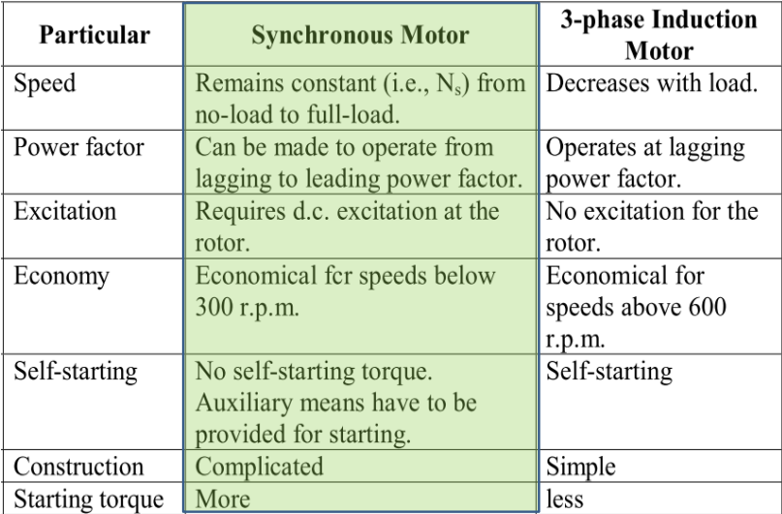
Comparison of SM & Induction Motors

Slide 15
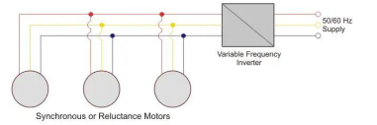
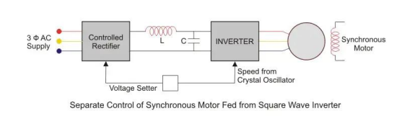
A combination of rectifiers and inverters can be used to control the speed of synchronous motors. There are two main methods for this:
Inverter Fed Open Loop Synchronous Motor Drive
In this method, the synchronous motor is supplied by a variable frequency inverter in an open loop. Open loop means there is no feedback to the supply, so the inverter doesn’t know the rotor’s position. This method is suitable when precise speed control isn’t necessary. The main supply is fed into a rectifier inverter set to achieve the desired frequency. The motor’s synchronous speed can be varied according to this frequency.
In above figure, you can see the block diagram of the speed control drive. The three-phase supply from the mains is converted to dc by using rectifiers. Then the rippled dc is smoothened by using LC filters. The DC is fed to the inverters. These inverters can be either voltage source inverters or current source inverter. The frequency of the supply fed to the motor can be varied and accordingly speed control of synchronous motor can be done. Open loop operation is useful when a number of motors need to be run at exactly the same speed. This method has a disadvantage though. This method causes spontaneous oscillation or hunting.

Slide 16
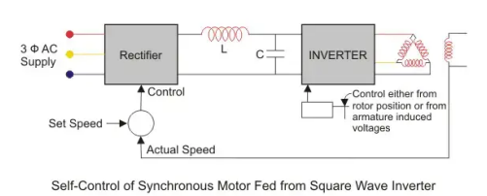
Self Synchronous (Closed – Loop) Operation
Self-synchronous (closed-loop) operation is used for precise speed control. Here, the inverter output frequency is based on the rotor speed. The rotor speed is fed back to a differentiator, and the difference between preset and actual speed is sent to the rectifier. The inverter then adjusts the frequency to control the motor speed accurately
For example, if the speed drops due to increased load, the stator supply frequency reduces to keep the rotor in sync with the stator magnetic field. This method prevents spontaneous oscillation or hunting.

Slide 17
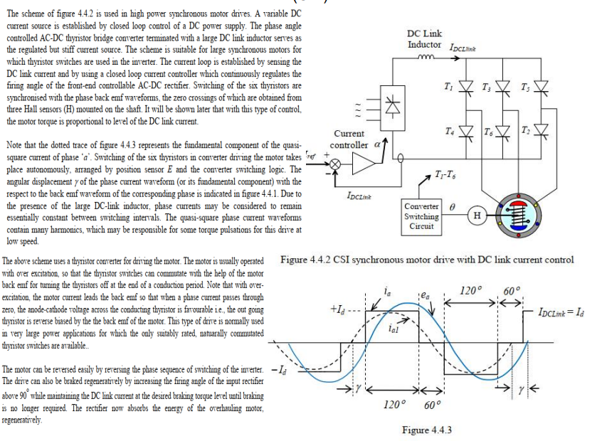
Performance with current-source inverter (CSI) drive

Slide 18
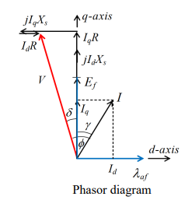
Brushless DC operation of CSI driven synchronous motor
In the following analysis, it is assumed that the supply current waveform for each phase is sinusoidal and of controllable amplitude or RMS value. It is also assumed that the phase angle between current and induced back emf in each phase can be arbitrarily chosen. All of these tasks are arranged through continuous rotor position feedback and continuous control of stator currents in closed loops. In other words, phase current references, and hence actual rotor currents, are assumed to be synchronised with the rotor position (angle). [In a more general sense, this type of control is equivalent to controlling the motor currents in the rotor reference frame].

Slide 19
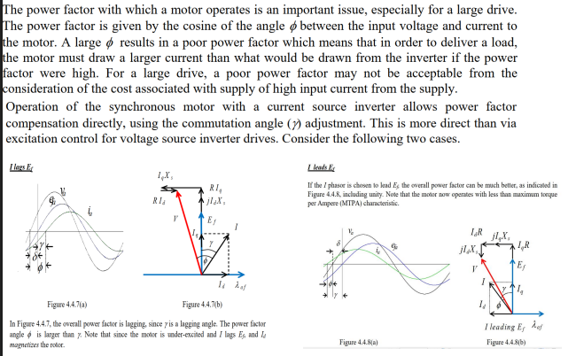
Unity power factor operation

Slide 20
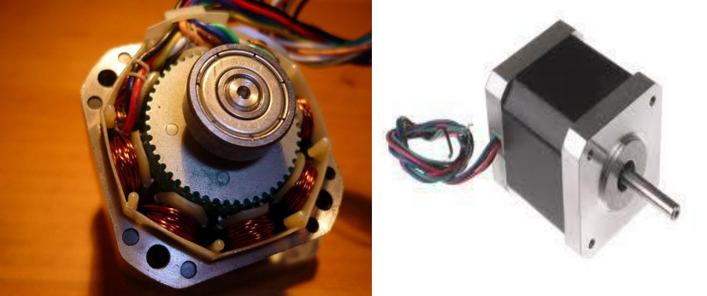
Stepper Motors

Slide 21
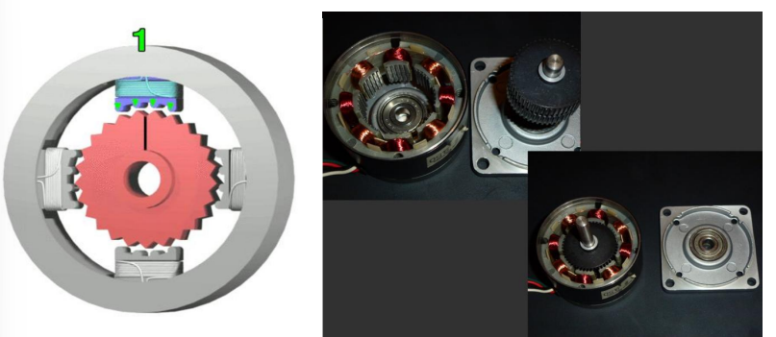
Stepper Motor
➢ A stepper motor or step motor or stepping motor is a brushless DC electric motor that divides a full rotation into a number of equal steps.
➢The stepper motor is known by its property to convert a train of input pulses (typically square wave pulses) into a precisely defined increment in the shaft position. Each pulse moves the shaft through a fixed angle called step angle.

Slide 22
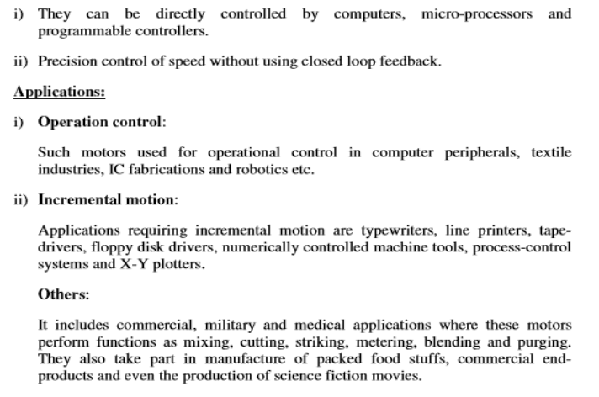
Advantages of stepper motors

Slide 23
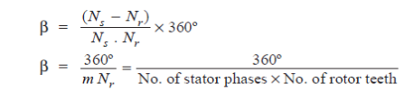
Step Angle
The angle through which the motor shaft rotates for each command pulse is called the step angle B. Smaller the step angle, greater the number of steps per revolution and higher the resolution or accuracy of positioning obtained. The step angles can be as small as 0.72° or as large as 90°. But the most common step sizes are 1.8°, 2.5°, 7.5° and 15°.
The value of step angle can be expressed either in terms of the rotor and stator poles (teeth) N, and N, respectively or in terms of the number of stator phases (m) and the number of rotor teeth..
For example, if N, = 8 and N, = 6, ẞ= (8-6) x360/8 x 6= 15°
Resolution is given by the number of steps needed to complete one revolution of the rotor shaft. Higher the resolution, greater the accuracy of positioning of objects by the motor
A stepping motor has the extraordinary ability to operate at very high stepping rates (upto 20,000 steps per second in some motors) and yet to remain fully in synchronism with the command pulses. When the pulse rate is high, the shaft rotation seems continuous. Operation at high speeds is called 'slewing'. When in the slewing range, the motor generally emits an audible whine having a fundamental frequency equal to the stepping rate. Iff is the stepping frequency (or pulse rate) in pulses per second (pps) and ẞ is the step angle, then motor shaft speed is given by

Slide 24
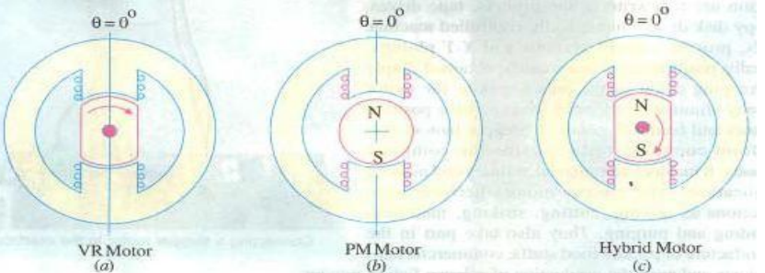
Stepper Motor Types:
There are three basic stepper motor types:
(i) Variable- reluctance (VR) stepper motor,
(ii) Permanent-magnet (PM) stepper motor and
(iii) Hybrid stepper motor…

Slide 25
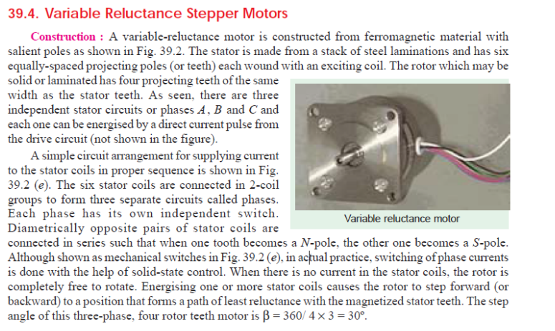
Variable Reluctance Stepper Motors

Slide 26
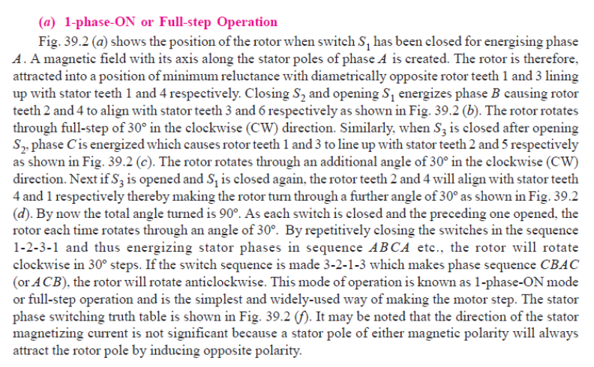
1-phase-ON or Full-step Operation

Slide 27
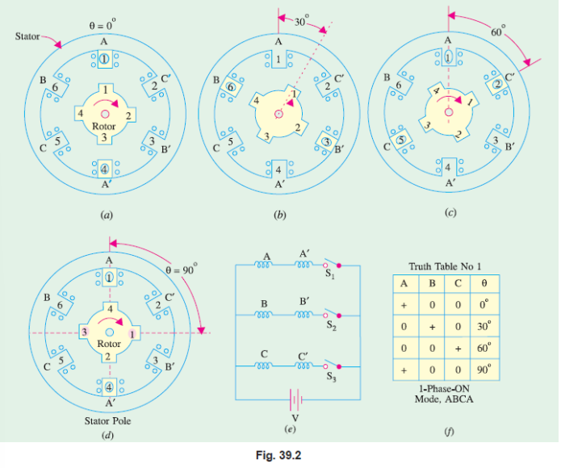

Slide 28
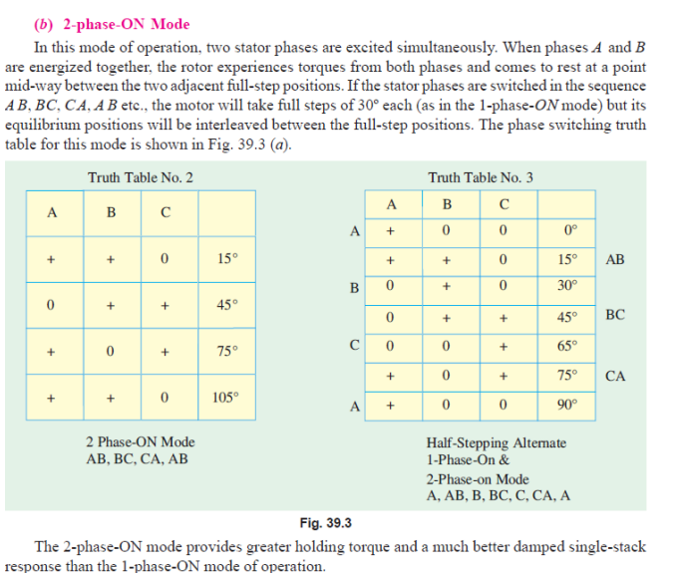
2-phase-ON Mode

Slide 29
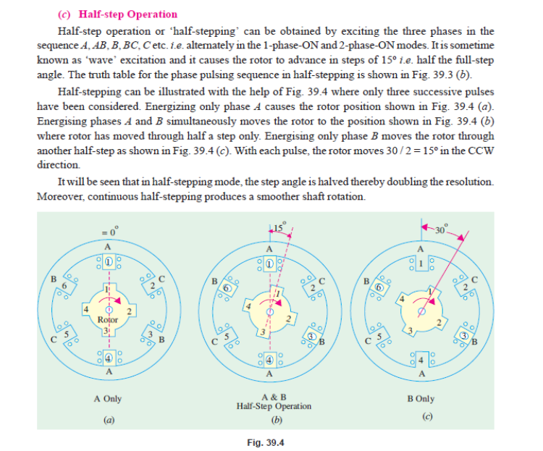
Half-step Operation

Slide 30
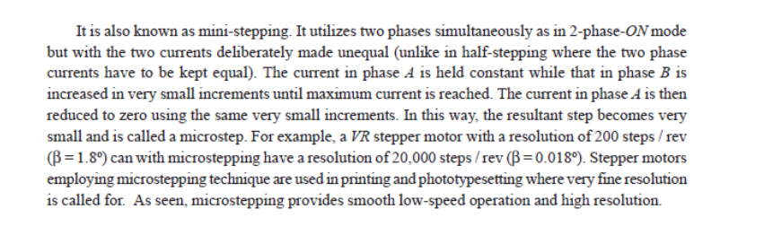
No Load Test/Open Circuit Test
What is micro-stepping?

Slide 31
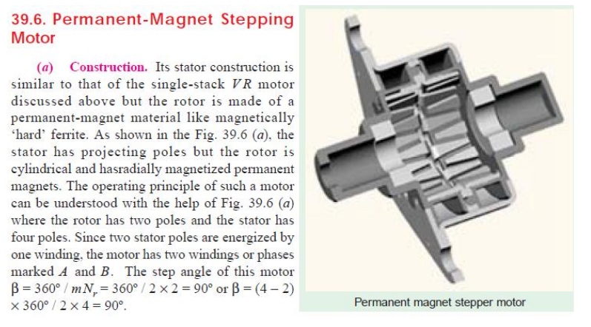
Permanent Magnet Stepper motor
It has wound stator poles and permanently magnetized rotor poles. It has a cylindrical rotor. Its direction of rotation depends on the polarity of stator current. The stator has projecting poles. Rotor has 2 poles whereas stator has 4 poles and the two stator poles are energized by one winding, the motor has two windings or phases.

Slide 32
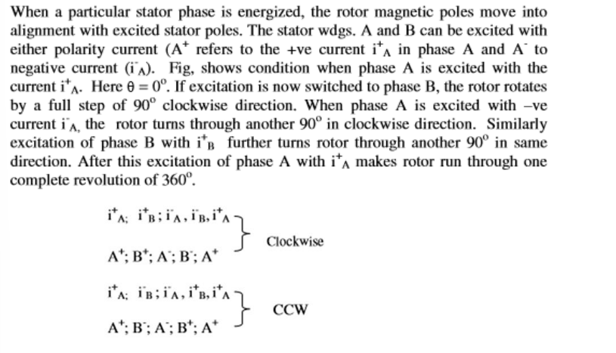
Working

Slide 33
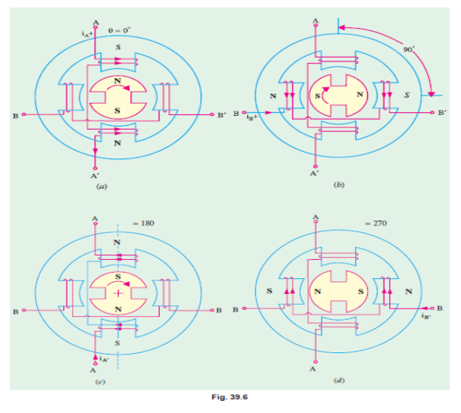

Slide 34


